Slide 1
Is the future of the US ... Italy ??

Slide 2
About me
Prof. Nicola Persico
Born and raised in Italy
Career in the US
NU Econ PhD
at Kellogg since 2011
Expert in business and government
Notes:
Goal in this class: expose you to a super-important aspect of doing business. This is doing business with the government, or in the shadow of government regulations. You need to know the terrain, and this is the class that teaches you this.

Slide 3
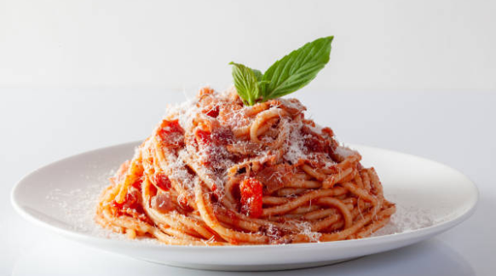
Italy is a great place to visit
Notes:
Source: IMF

Slide 4
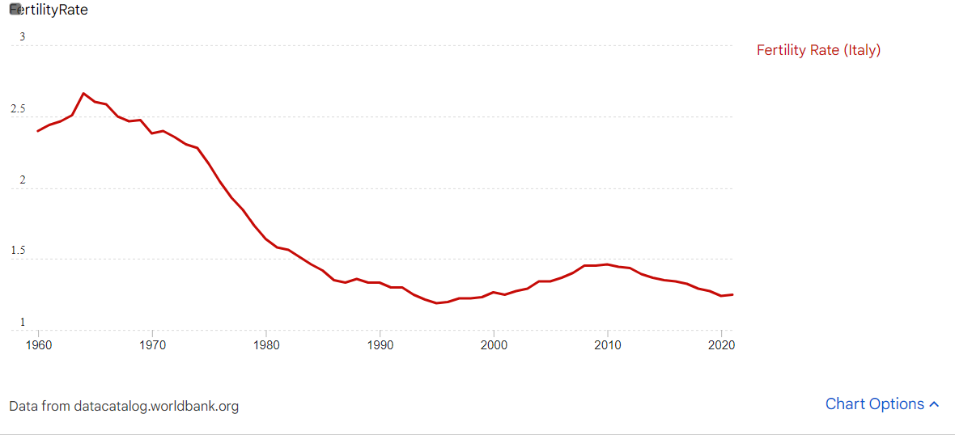
… but young Italians are not having children
Notes:
The total fertility rate in a specific year is defined as the total number of children that would be born to each woman if she were to live to the end of ...

Slide 5
Discouraged youth
For decades, young Italians have been discouraged about their economic possibilities
many don’t work
most struggle to buy a house or apartment
they don’t think they will be able to have the same life as their parents
In the US, it used to be the opposite
young people expected to be able to buy a home
… and to do better than their parents
But, recently, young Americans have become discouraged about their economic future
many have student debt
many don’t think that buying a home is a realistic goal
they don’t expect to do better than their parents
Are young Americans experiencing the first symptoms of a low-growth era?
Notes:
Employment rate by age group15-24 year-olds, % in same age group, Q3 2023 or latest available: USA 50%, Italy 20%.
A Wall Street Journal-NORC poll from March found that just 21 percent of respondents felt confident that life for their children’s generation will be better, matching the record low since this question was first asked. In 1990, 50 percent of those asked felt life would be better for their kids.
The pessimism is easy to understand.
Consider one marker of generational progress: moving out. Nearly half of all Americans aged 18-29 live at home with their parents, the highest share since the Great Depression. In recent decades, rents in American cities have far outstripped income growth for young Americans, even those with college degrees.

Slide 6
Italy as a low-growth cautionary tale
GDP per capita, 1990
USA | Italy
23,000 | 20,000
now
USA | Italy
80,000 | 37,000
GDP per capita, current prices, US dollars. Source: https://www.imf.org/en/Countries

Slide 7
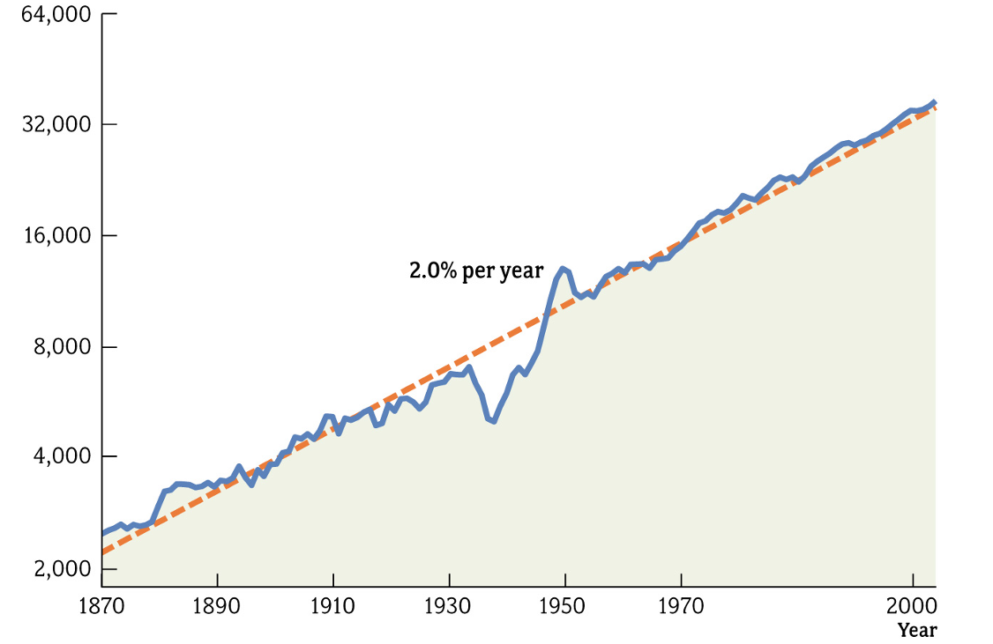
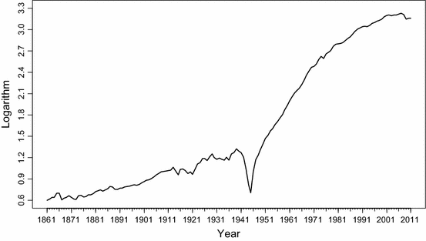
Historical trends: GDP per capita (in logs)
USA
Italy
Notes:
GDP per capita, current prices, log scale. Sources: Macroeconomics by Charles I Jones, 2008 Norton. Clementi, F., Gallegati, M. & Gallegati, M. Growth and Cycles of the Italian Economy Since 1861: The New Evidence. Ital Econ J 1, 25–59 (2015). https://doi.org/10.1007/s40797-014-0005-0.
Visually, the figures are stretched so same logGDP level in 1990.

Slide 8
Historical trends: GDP per capita (in logs)
USA
Italy
Notes:
GDP per capita, current prices, log scale. Sources: Macroeconomics by Charles I Jones, 2008 Norton. Clementi, F., Gallegati, M. & Gallegati, M. Growth and Cycles of the Italian Economy Since 1861: The New Evidence. Ital Econ J 1, 25–59 (2015). https://doi.org/10.1007/s40797-014-0005-0.
Visually, the figures are stretched so same logGDP level in 1990 and same time window, so orange line is the same in the two graphs.

Slide 9
Historical trends: GDP per capita (in logs)
USA
Italy
What went wrong?
Why did Italy fall behind?
Notes:
GDP per capita, current prices, log scale. Sources: Macroeconomics by Charles I Jones, 2008 Norton. Clementi, F., Gallegati, M. & Gallegati, M. Growth and Cycles of the Italian Economy Since 1861: The New Evidence. Ital Econ J 1, 25–59 (2015). https://doi.org/10.1007/s40797-014-0005-0.
Visually, the figures are stretched so same logGDP level in 1990 and same time window, so orange line is the same in the two graphs.

Slide 10
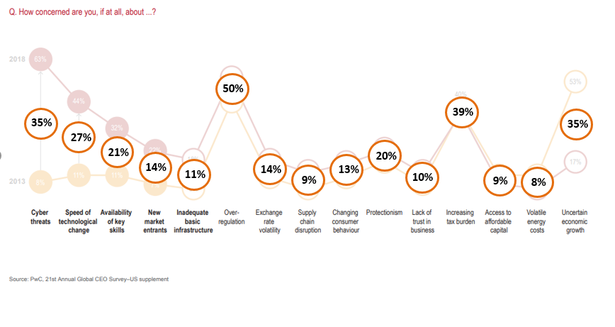
What stops growth? According to CEOs …
Over-regulation
Taxation
Elaboration from PwC survey, average 2013-18

Slide 11
Factors that stunted Italy’s growth
Over-regulation
Taxation
Too many laws
Bureaucracy is slow
Judicial system is slow
Taxes are high
... because government is broke
Notes:
What is regulation: labor market restrictions (can’t fire, double the salary of any employee due to taxes)
What is taxation: not only direct taxation, but also indirect (employee example mentioned before, but also half of energy prices are taxes so energy very expensive)
Why regulation matters: it takes 1bn to get a new drug approved by the FDA, it takes 100k to start a new software company. So, we were promised the end to cancer, but instead we have free internet access. (Same with nuclear energy)

Slide 12
How is the US doing on these dimensions?
The US government is now broke also: Debt/GDP = 120%
Even more broke than 1990 Italy
So, taxes will increase a lot soon
Fortunately, US is doing better on over-regulation ...
Debt / GDP
USA today | Italy 1990
120% | 100%
Notes:
Source: IMF

Slide 13
Fortunately, US does better on paperwork costs
Days of paperwork required to start a business
USA | Italy
5 | 11
Cost of paperwork required to start a business
USA | Italy
$800 | $4,000
Cost of paperwork required to build a warehouse
USA | Italy
1% of warehouse value | 4% of warehouse value
Notes:
SOURCE: WB Doing Business Survey
The time for men captures the median duration that business incorporation experts indicate is necessary for five male married entrepreneurs to complete all procedures required to start and operate a business with minimum follow-up and no extra payments. It is calulared in calendar days. The time estimates of all procedures are added to calculate the total time required to start and operate a business, taking into account simultaneity of processes. It is assumed that the minimum time required for each procedure is one day, except for procedures that can be fully completed online, for which the time required is recorded as half a day.
The cost for men is the total cost required for five male married entrepreneurs to complete the procedures to incorporate and operate a business. It is calculated as a percentage of income per capita. All the fees and costs associated with completing the procedures to start a business are recorded, including all official fees and fees for legal and professional services, if such services are required by law or commonly used in practice. Only incorporation costs are counted, which excludes value added taxes and bribes.
The cost records all official costs associated with completing the procedures to legally build a warehouse, including the costs associated with obtaining land use approvals and preconstruction design clearances; receiving inspections before, during and after construction; obtaining utility connections; and registering the warehouse at the property registry. It is calculated as a percentage of the warehouse value. Nonrecurring taxes required for the completion of the warehouse project are also recorded. Sales taxes (such as value added tax) or capital gains taxes are not recorded. Nor are deposits that must be paid up front and are later refunded.

Slide 14
Other EU countries prove the point
UK, Germany, Spain, France did not experience stunted growth like Italy
And, as of 2019 (pre-pandemic), Italy does worse on both dimensions (over-regulation and on need to tax) than all these countries!
 | Ease of Doing Business | Debt/GDP ratio (need to tax)
USA | 8 | 100%
UK | 9 | 80%
Germany | 24 | 60%
Spain | 30 | 100%
France | 32 | 100%
Italy | 51 | 130%

Slide 15
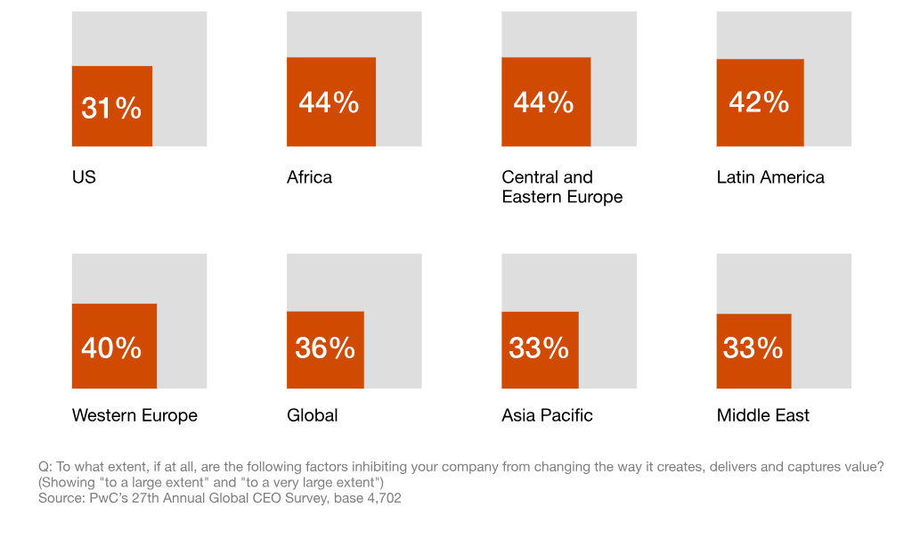
Fortunately, the US is still comparatively good on regulation
CEOs who say that regulations majorly interfere with value creation

Slide 16
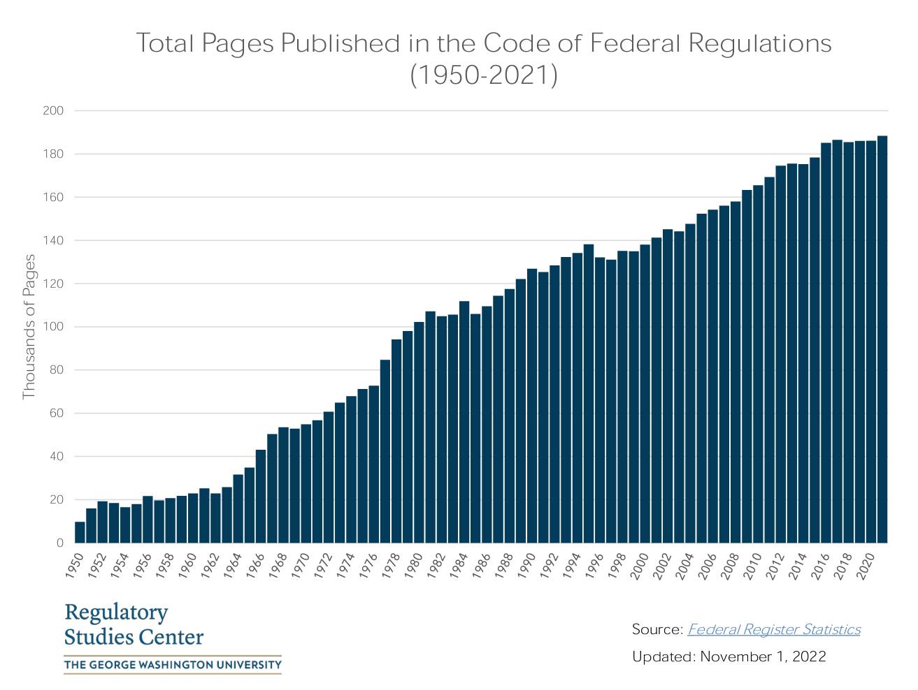
But regulation is increasing fast in the US, too

Slide 17
In conclusion ...
CEOs say that economic growth is majorly limited by regulation and taxes
On taxes, US is now more broke than Italy in 1990, so taxes will get worse fast
On regulation, US is still less regulated than Italy (and the world)
Maybe the US is under-regulated, but …
IF we want economic growth, it’s critical for the US to preserve this source of competitive advantage

Slide 18
AMA
(ask me anything)

Slide 19
CEOs are most concerned about ...
Over-regulation
Taxation
Elaboration from PwC survey, average 2013-18

Slide 20
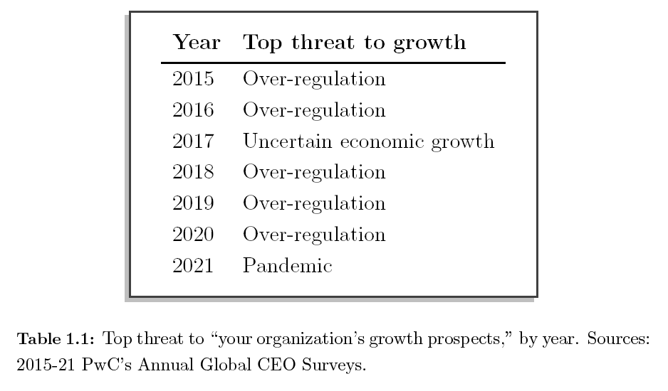
Over-regulation top threat to growth

Slide 21
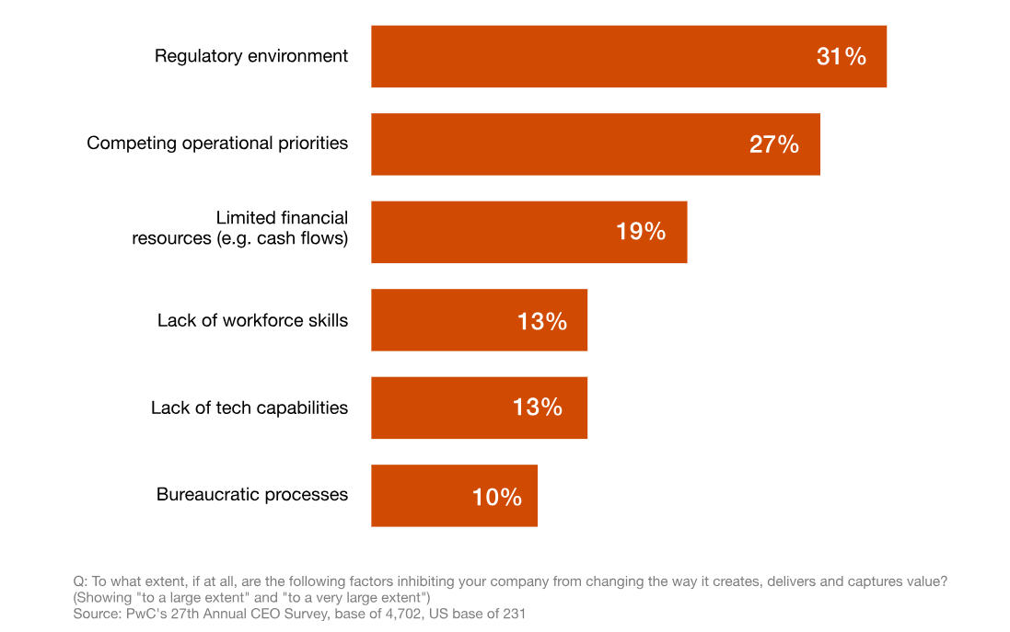
US CEOs: biggest impediment to creating value

Slide 22
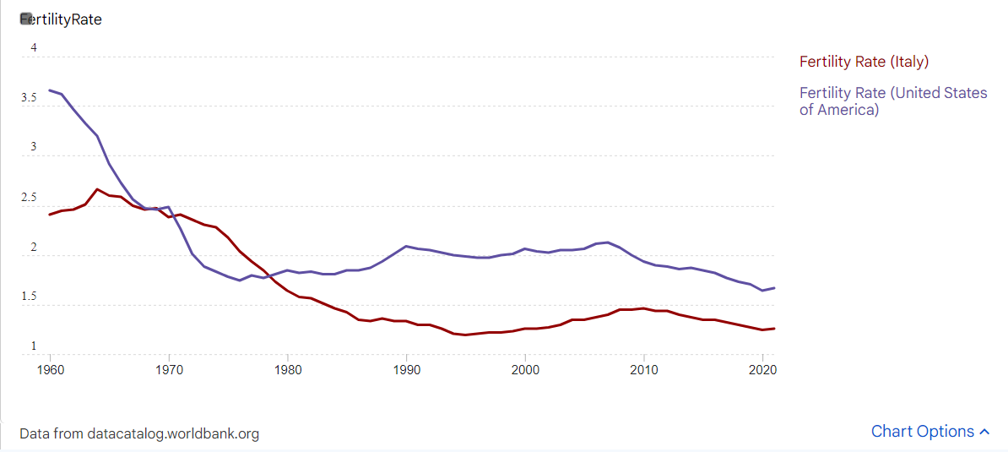
Fertility rate USA v Italy

